Slide 1
Black Box Testing Use Case Testing
Prepared By Chala Urgessa

Slide 2
Use Case Testing
Use case testing helps find test cases that check the system for each transaction, from beginning to end.
用例测试帮助找到逐个事务检查系统的测试案例，从头到尾。
A use case is how an actor (someone or something using the system) uses it.
用例是行动者（使用系统的某人或某物）如何使用它。
Each use case shows the actor's steps with the system to complete a task or create value.
每个用例展示了行动者为了完成任务或创造价值而与系统的互动步骤。
Actors are usually people, but can also be other systems. Use cases list these steps and interactions.
行动者通常是人，但也可以是其他系统。用例列出了这些步骤和互动。

Slide 3
The Bug Hypothesis
Use case testing aims to find errors when:
The system doesn't interact correctly with the user.
系统与用户的互动不正确。
The system gives the wrong result.
系统提供了错误的结果。

Slide 4
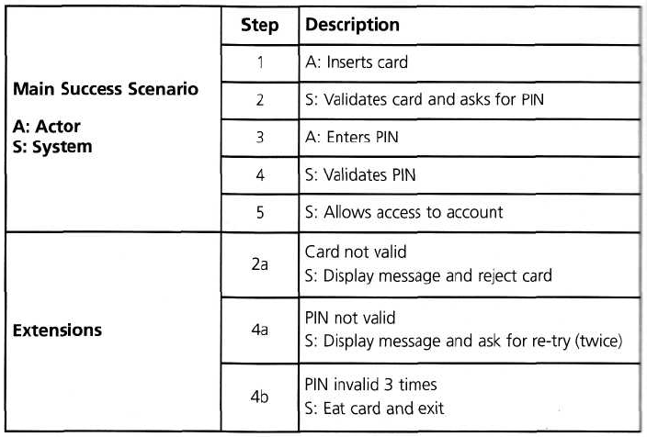
Use Case Testing
The PIN example that we used for state transition testing could also be defined in terms of use cases

Slide 5
When to Use What…
When you want to test scenarios that have… | The most effective black box testing technique is likely to be…
Output values are dictated by certain conditions depending upon values of input variables | Decision Tables
Input values being in ranges, with each range exhibiting a particular functionality | Boundary Value Analysis
Input values being divided into classes (like ranges, list of values, etc), with each class exhibiting a particular functionality | Equivalence Partitioning
 | Positive and negative testing
Workflows, process flows or language processors | Graph based testing
To ensure that requirements are tested and met properly | Requirements Based Testing
To test using the domain expertise rather than the product specification | Domain Testing
To ensure that the documentation is consistent with the product | Documentation Testing

